Slide 1

Important Features introduced in HTML5

Slide 2
HTML5
HTML5 is the fifth major version of the Hypertext Markup Language.
These advantages of HTML5 make it a powerful and flexible tool for web development, enabling developers to create modern, interactive, and cross-platform web applications

Slide 3
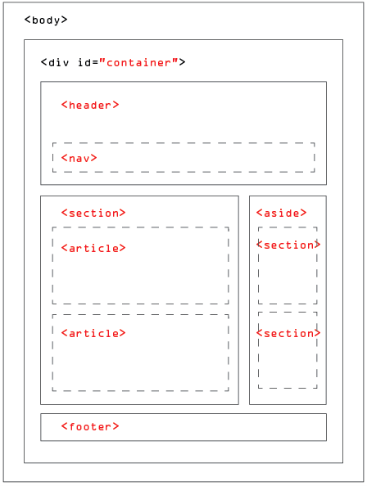
Basic Structure of a HTML5 Page
Elements of HTML5 page
<header>
<nav>
<section>
<article>
<aside>
<footer>

Slide 4
Features Introduced in HTML5
Audio & Video
Location based Services
New Input Types
Local Storage
Session Storage
Responsive Web Design

Slide 5
Audio and Video
Before HTML5 there is no standard for playing audio and video files on a webpage which generally requires a plug-in for different formats of audio and video .
Examples of audio and video tags
<audio controls><source src=”guitar.mp3” type=”audio/mpeg”>This is audio element</audio>
<video width= “480” height= “480” controls><source src=”clouds.mp4” type=”video/mp4”></video>
Link to audio and video tag example: https://codepen.io/vishnu-tavanam/pen/dygxEvx

Slide 6
Location based Services
HTML5 provides several location-based services that allow web applications to access and utilize the user's geographic location. The main feature for this is the Geolocation API.
Example:https://codepen.io/vishnu-tavanam/pen/PoyMvbN

Slide 7
New input types
HTML5 introduced new input types for simplifying the web page designing, even they have inbuilt support for CSS and JS. So, these new input types provide better input control and validations.
Example:https://codepen.io/vishnu-tavanam/pen/yLRmWMv

Slide 8
Local Storage
In HTML5, the Local Storage API provides a way to store key-value pairs locally within the user's web browser. The data stored using the Local Storage API persists even when the user navigates away from the website or closes the browser.
Local Storage persists even if browser is closed and reopened.
Example:https://codepen.io/vishnu-tavanam/pen/poxMmwp

Slide 9
Session Storage
The session Storage object stores data for a single session. The stored data will be available as long as the browser window or tab is open and will be cleared when the session is terminated (e.g., when the window or tab is closed).
Example:https://codepen.io/vishnu-tavanam/pen/rNqXgGZ

Slide 10
Responsive Web design
Although not exclusive to HTML5, this version introduced features that facilitated responsive web design. It introduced media queries, which allow developers to apply different styles and layouts based on the device's screen size or resolution. This made it easier to create websites that adapt and display properly on different devices, such as desktops, tablets, and smartphones.

Slide 11
Advantages
It provides numerous advantages like,
Simplified Code
Cross-Platform Compatibility
Multimedia Support
Mobile-Friendly and Responsive Design

